Slide 1
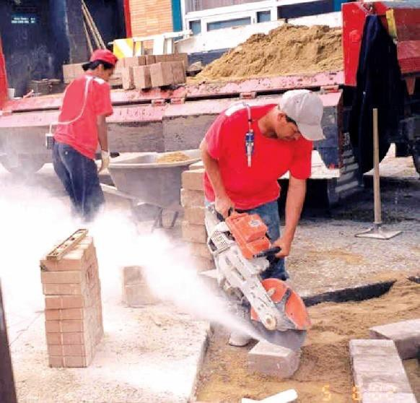

Keep Your Head Out of the Clouds! Silica in General Industry and Construction An Overview of MIOSHA Part 590 and Part 690
Gregg Grubb, CIH
MIOSHA
Consultation Education and Training Division Lansing, Michigan
grubbg@michigan.gov
1

Slide 2


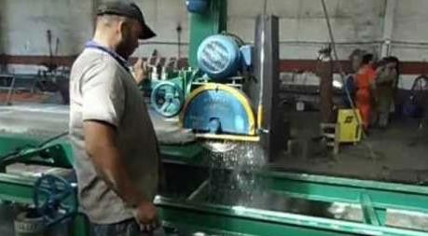
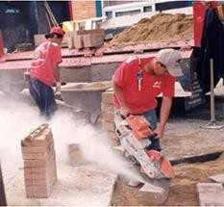
Objective
To provide an overview of MIOSHA Part 590, Silica in General Industry and MIOSHA Part 690, Silica in Construction.
1

Slide 3

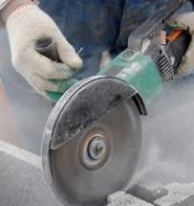

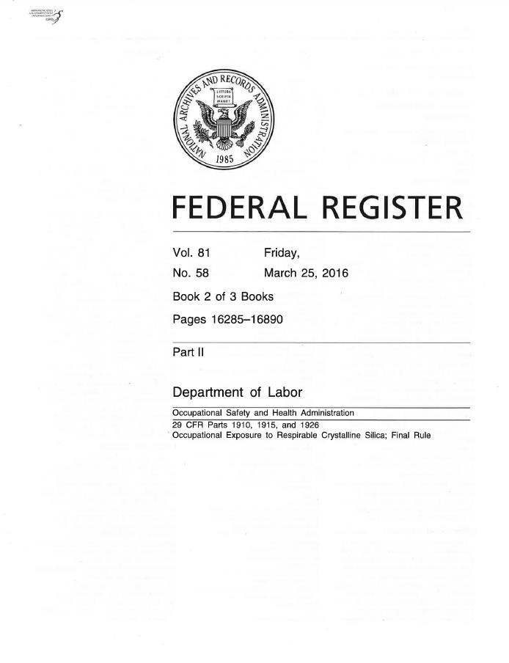
New MIOSHA Silica Standards
Adopt two federal OSHA standards published in 2016.
Impact both General Industry and Construction
activities (maritime is protected by federal OSHA).
Address employee exposures to respirable
crystalline silica.
Reasons for the new standard:
  Current PELs do not adequately protect construction and general industry employees.
  Extensive epidemiologic evidence that lung cancer and silicosis occur at exposure levels below 100 µg/m³.
1

Slide 4

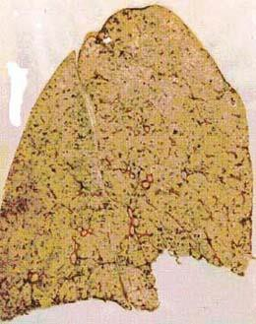

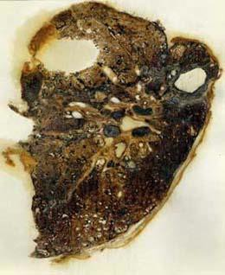
Exposure and Health Risks
OSHA estimates more than 840,000 employees in construction and more than 100,000 employees in general industry are exposed to workplace silica levels that exceed the revised PEL.
Exposure to respirable crystalline silica has been
linked to:
  Silicosis,
  Lung cancer,
  Chronic obstructive pulmonary disease, and
  Kidney disease.
Healthy Lung
Silicotic Lung
4

Slide 5

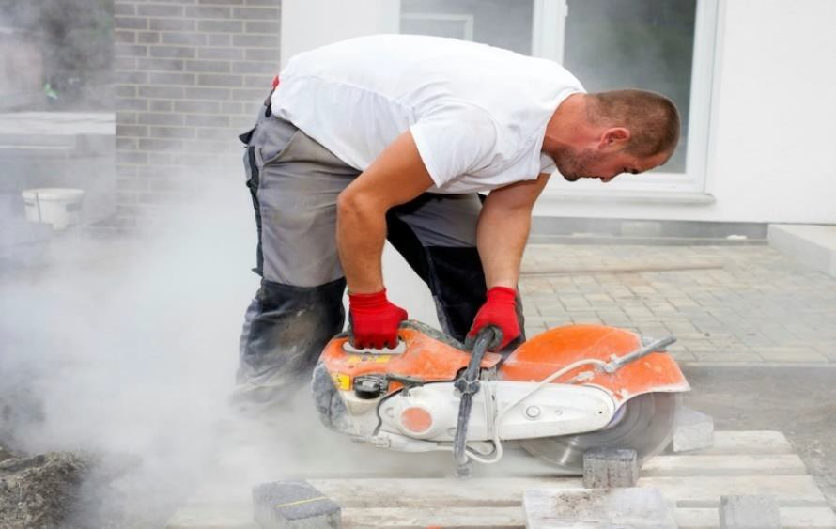

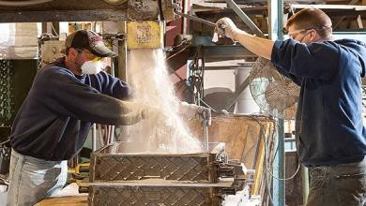
Workers and Industries Affected Nationally
2.3 million workers protected:
Construction:
GI/Maritime:
2,000,000
300,000
676,000 establishments impacted:
Construction:
GI/Maritime:
600,000
76,000
5

Slide 6

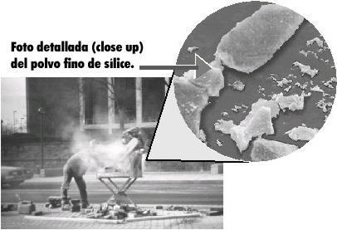
MIOSHA Silica Standards
Address respirable crystalline silica exposures:
Two standards in Michigan:
  MIOSHA Part 590, Silica in
General Industry.
  MIOSHA Part 690, Silica in
Construction.
  Maritime industry is addressed by federal OSHA.
Adopts the federal OSHA
requirements by reference.
Close-up photo detail of fine silica.
5

Slide 7
Tasks/Activities At Risk of Exposure to Silica
Not An All-Inclusive Listing
Construction
Using tools and heavy equipment for demolition.
Chipping, cutting, sawing, drilling, grinding, sanding, and crushing of concrete, brick, block, rock, and stone products.
Use of sand products.
Use of handheld power saws without dust controls to cut concrete.
General Industry
Asphalt Roofing Materials
Concrete Products
Cut Stone
Dental Laboratories
Foundries
Jewelry
Porcelain Enameling
Pottery
Railroads
Ready-Mix Concrete
Shipyards
Structural Clay Products
Support Activities for Oil and Gas Operations
5

Slide 8
Silica in General Industry
MIOSHA Part 590 (adopts 29 CFR 1910.1053)
Scope and application
Definitions (11 terms)
Permissible exposure limit (PEL)
Exposure assessment:
  General
  Performance option
  Scheduled monitoring option
  Reassessment of exposures
  Methods of sample analysis
  Employee notification of assessment results
Regulated areas
Methods of compliance
Respiratory protection
Housekeeping
Medical surveillance
“Communication of silica
hazards”
Recordkeeping
Dates
BOLD TEXT references similar information
– Observation of monitoring
and content both OSHA silica standards.
8

Slide 9
Silica in Construction
MIOSHA Part 690 (adopts 29 CFR 1926.1153)
Scope and application
Definitions (11 terms)
Specified exposure control
methods,
…OR…
Alternative exposure control
methods:
  Permissible exposure limit (PEL)
  Exposure assessment
  Methods of compliance
Respiratory protection
Housekeeping
Written exposure control plan
Medical surveillance
“Communication of silica
hazards”
Recordkeeping
Dates
BOLD TEXT references similar information and content both OSHA silica standards.
9

Slide 10

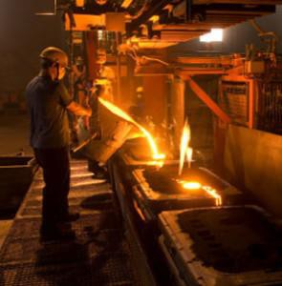
Scope: General Industry
Part 590, Rule 59001
Applies to all occupational exposures to respirable crystalline silica except: construction work, agricultural operations, and exposures that result from working with sorptive clays.
Does not apply:
  Where employee exposures will remain below
25 micrograms per cubic meter of air (25
µg/m³) as an 8-hour time weighted average (TWA) under any foreseeable conditions (objective data).
  If employer complies with Part 690, the task is listed in Table 1, and will not be performed regularly in the same environment and conditions.

Slide 11

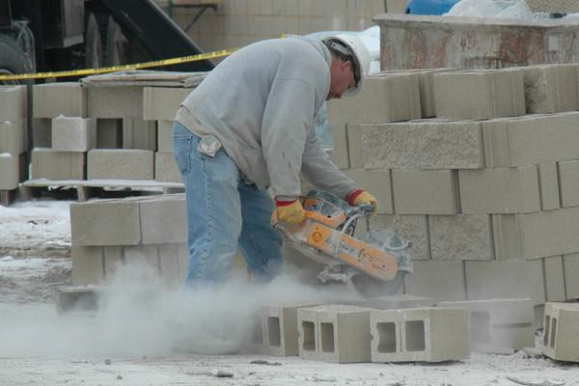
Scope: Construction
Part 690, Rule 69001
Applies to all occupational exposures to respirable crystalline silica in construction work,
Except where employee exposure will remain below 25 micrograms per cubic meter of air (25 µg/m³) as an 8-hour time weighted average (TWA) under any foreseeable conditions.

Slide 12
Definitions
Part 590, Rule 59015 or Part 690, Rule 69015
General Industry Standard (Part 590)
Action level
Assistant Secretary
Competent person
Construction Standard (Part 690)
Action level
Assistant Secretary
Competent person
Director
Employee exposure
High-efficiency particulate air (HEPA) filter
Objective data
Physician or other licensed health care professional (PLHCP)
Respirable crystalline silica
Director
Employee exposure
High-efficiency particulate air (HEPA) filter
Objective data
Physician or other licensed health care professional (PLHCP)
Regulated area
Respirable crystalline silica
Specialist
This section
Specialist
This section
Bold text on this slide represents terms defined in this presentation.
Red stars denote errata in MIOSHA Part 590.
12

Slide 13

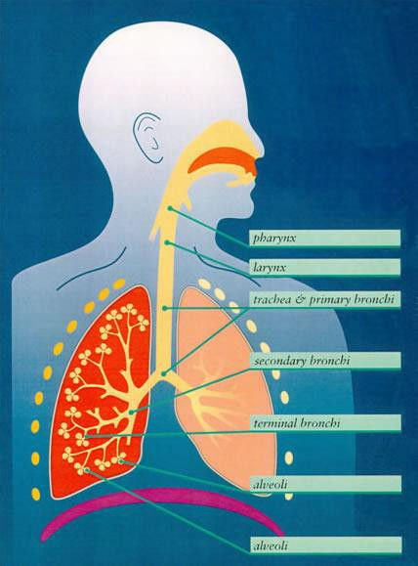
Definition: Respirable Crystalline Silica
Part 590, Rule 59015 (9) and Part 690, Rule 69015 (9)
Silica is comprised of crystalline quartz, cristobalite, and/or tridymite.
The respirable fraction (10 microns in diameter or less) is of greatest concern as these tiny, dagger-like particles have the potential to reach the delicate alveolar lung tissue.

Slide 14
Definition: Objective Data
Part 590, Rule 59015 (7) and Part 690, Rule 69015 (7)
Information, such as air monitoring data from industry- wide surveys or calculations based on the composition of a substance, demonstrating employee exposure to respirable crystalline silica associated with a particular product or material or a specific process, task, or activity.
The data must reflect workplace conditions closely resembling (or with a higher exposure potential than the processes), types of material, control methods, work practices, and environmental conditions in the employer’s current operations.

Slide 15





Objective data must include…
The crystalline silica material in question.
The source of the objective data.
The testing protocol and results of the testing.
Other data relevant to the process, task, activity, material, or exposures on which the objective data is based.
Description of the process, task, or activity on which the objective data were based.
The employer shall ensure that objective data are maintained and made available in accordance with 29 CFR 1910.1020 (i.e., MIOSHA Part 470).

Slide 16
Objective Data Example
Jobsite A: Exposure monitoring reveals employee exposures = 20 μg/m³; use of portable handsaw to cut the concrete floor in a 40’ × 40’ × 10’, vented room; wet methods and HEPA vacuums are used; the concrete is 15% crystalline quartz.
Jobsite B: No exposure monitoring has been performed; the employer wishes to use data from Jobsite A. The work at this site involves use of a portable handsaw to cut the concrete floor in a 20’ × 20’ × 8’, unvented room; wet methods and HEPA vacuums are used; the concrete is 25% crystalline quartz.
Can the employer use the data obtained at Jobsite A to
represent employee exposures at Jobsite B?
NO, due to the elevated silica
content and decrease in room size.
16

Slide 17
Definition: Competent Person
Part 690, Rule 69015 (4)
Capable of identifying existing and foreseeable respirable crystalline silica hazards.
Has authorization to take prompt corrective measures to
eliminate or minimize identified hazards.
Has the knowledge and ability necessary to fulfill the responsibilities set forth in the written exposure control plan section of the standard: 1926.1153 (g).
Makes frequent and regular inspection of job sites,
materials, and equipment.
Errata: No similar definition should exist in MIOSHA Part 590.

Slide 18

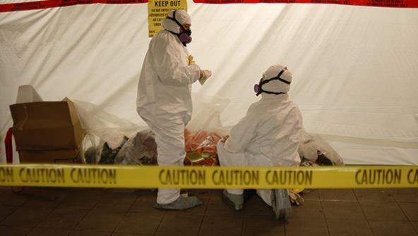
Definition: Regulated Area
Errata: Should be listed as Part 590, Rule 59015 (8)
An area, demarcated by the employer, where an
employee’s exposure to airborne concentrations of respirable crystalline silica exceeds, or can reasonably be expected to exceed, the
PEL.
Note the improper use of respiratory protection (i.e., the respirator should be the first PPE on and the last off; the straps should be under the hood.

Slide 19
Silica Exposure Limits
Part 590, 1910.1053 (c) or Part 690, 1926.1153 (d)(1)
> 50 µg/m³
> 25 µg/m³
< 25 µg/m³
PEL: permissible exposure limit 50 µg/m³, 8-hr TWA
AL: action limit
25 µg/m³, 8-hr TWA
DANGER
CAUTION
“PERMISSIBLE”

Slide 20
Exposure Assessment and Control
Part 590, General Industry
Permissible exposure limit (PEL)
Exposure assessment
Regulated areas
Methods of control:
  Engineering and work practice
controls
  Written exposure control program
  Abrasive blasting
Part 690, Construction
29 CFR 1926.1153 (c): Table 1
  Table 1
  Means of exhaust, wet methods, and enclosed cabs/booths
  Multiple Table 1 tasks performed during a work shift
29 CFR 1926.1153 (d):
  Permissible exposure limit (PEL)
  Exposure assessment
  Methods of compliance
…OR…
20

Slide 21
Specified Exposure Control Methods
Part 690, 1926.1153 (c)
For each employee engaged in a task identified on Table 1, the employer shall fully and properly implement the engineering controls, work practices, and respiratory protection specified for the task on Table 1, unless the employer assesses and limits the exposure of the employee to respirable crystalline silica in accordance with paragraph (d) of this section.
Employees are “engaged in a task” when:
  Operating the listed equipment,
  Assisting with the task, OR
  Having some responsibility for the completion of the task.
Employees are not “engaged in a task” if they are only in the vicinity
of a task.

Slide 22
Specified Exposure Control Methods
Part 690, 1926.1153 (c)(1), Table 1 Equipment/Tasks
Stationary masonry saws
Handheld power saws
Handheld power saws for cutting fiber-cement
board
Walk-behind saws
Drivable saws
Rig-mounted core saws or drills
Handheld and stand-mounted drills
Dowel drilling for concrete
Vehicle-mounted drilling rigs for rock and
concrete
Handheld grinders for mortar removal (i.e., tuckpointing)
Handheld grinders for uses other than mortar
removal
Walk-behind milling machines and floor grinders
Small drivable milling machines
Large drivable milling machines
Crushing machines
Heavy equipment and utility vehicles used to abrade or fracture silica-containing materials
Heavy equipment and utility vehicles for tasks
such as grading and excavating
10. Jackhammers and handheld powered chipping tools

Slide 23

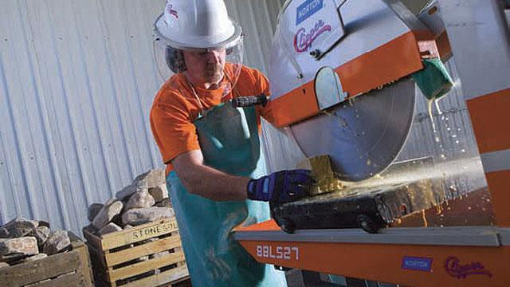
Example of Part 690 Table 1 Task/Activity
Stationary Masonry Saw

Slide 24
Example of Part 690 Table 1 Task/Activity
Stationary Masonry Saw
Equipment or Task | Engineering and Work Practice Control Methods | Required Respiratory Protection and Minimum APF
 |  | ≤ 4 hr/shift | > 4 hr/shift
Stationary masonry saws | Use saw equipped with integrated water delivery system that continuously feeds water to the blade. Operate and maintain tool in accordance with manufacturer’s instructions to minimize dust emissions. | None | None

Slide 25

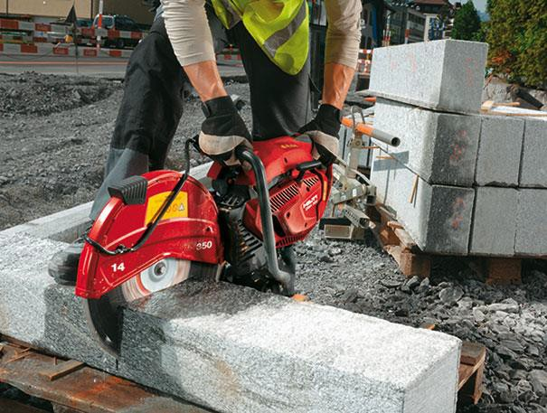
Example of Part 690 Table 1 Task/Activity
Handheld Power Saws (any blade diameter)

Slide 26
Example of Part 690 Table 1 Task/Activity
Handheld Power Saws (any blade diameter)
Equipment or Task | Engineering and Work Practice Control Methods | Required Respiratory Protection and Minimum APF
 |  | ≤ 4 hr/shift | > 4 hr/shift
Handheld power saws (any blade diameter) | Use saw equipped with integrated water delivery system that continuously feeds water to the blade. Operate and maintain tool in accordance with manufacturer’s instructions to minimize dust emissions. When used outdoors When used indoors or in an enclosed area | None APF 10 | APF 10 APF 10

Slide 27

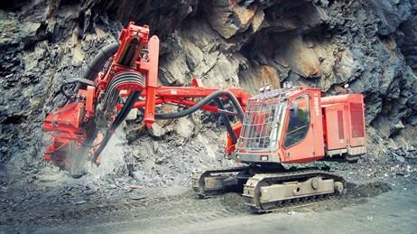
Example of Part 690 Table 1 Task/Activity
Vehicle Mounted Drilling Rigs for Rock and Concrete
Entry

Slide 28
Example of Part 690 Table 1 Task/Activity
Vehicle Mounted Drilling Rigs for Rock and Concrete
Equipment or Task | Engineering and Work Practice Control Methods | Required Respiratory Protection and Minimum APF
 |  | ≤ 4 hr/shift | > 4 hr/shift
Vehicle mounted drilling rigs for rock and concrete | Use dust collection system with close capture hood or shroud around drill bit with a low-flow water spray to wet the dust at the discharge point from the dust collector. OR Operate from within an enclosed cab and use water for dust suppression on drill bit. | None None | None None

Slide 29
Implementation of Table 1 Control Measures
Part 690, 1926.1153 (c)(2)
Tasks performed indoors or in enclosed areas
Tasks performed using wet methods
Measures implemented that include an enclosed cab or booth

Slide 30

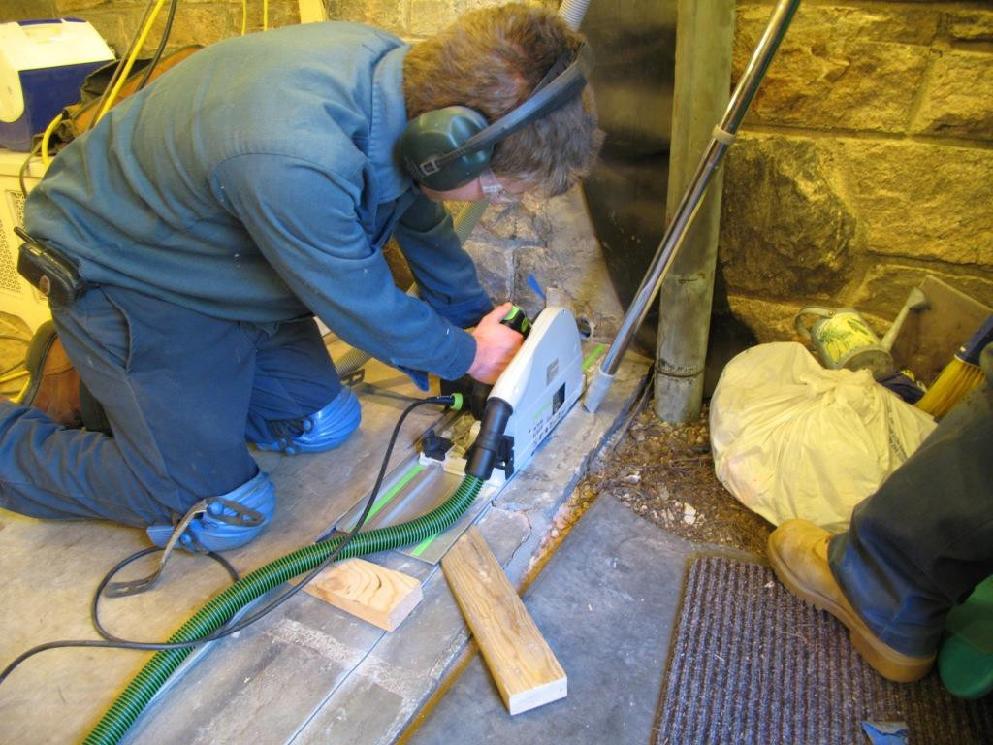
Tasks Performed Indoors or in Enclosed Areas
Part 690, 1926.1153 (c)(2)(i)
Provide a means of exhaust as needed to minimize the accumulation of visible airborne dust.
30

Slide 31

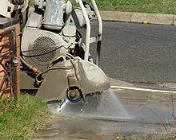
Tasks Performed Using Wet Methods
Part 690, 1926.1153 (c)(2)(ii)
Apply water at flow rates sufficient to minimize release of visible dust.

Slide 32

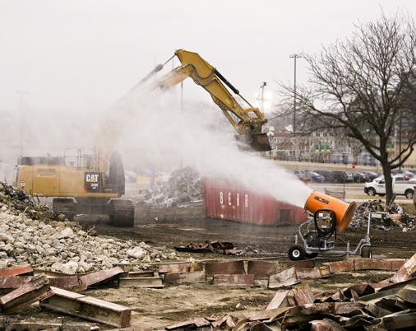
Measures Including an Enclosed Cab or Booth
Part 690, 1926.1153 (c)(2)(iii)
Ensure that the enclosed cab or booth:
Is maintained as free as practicable from settled dust;
Has door seals and closing mechanisms
that work properly;
Has gaskets and seals that are in good condition and working properly;
Is under positive pressure maintained
through continuous delivery of fresh air;
Has intake air that is filtered through a filter that is 95% efficient in the 0.3-10.0
µm range (e.g., MERV-16 or better); and
Has heating and cooling capabilities.

Slide 33
Performing > One Table 1 Task During a Shift
Part 690, 1926.1153 (c)(3)
Where an employee performs more than one task on Table 1 during the course of a shift, and the total duration of all tasks combined is more than four hours, the required respiratory protection for each task is the respiratory protection specified for more than four hours per shift.
If the total duration of all tasks on Table 1 combined is less than four hours, the required respiratory protection for each task is the respiratory protection specified for less than four hours per shift.

Slide 34

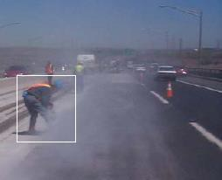
Alternative Exposure Control Methods
Part 690, 1926.1153 (d)
For tasks not addressed by Table 1, OR
Where one cannot fully and properly implement the engineering controls, work practices, and respiratory protection specified by Table 1, THEN
comply with paragraph (d).
Employee using demo saw without water control measures; exposure > 45× new OSHA PEL for respirable crystalline silica.
34

Slide 35

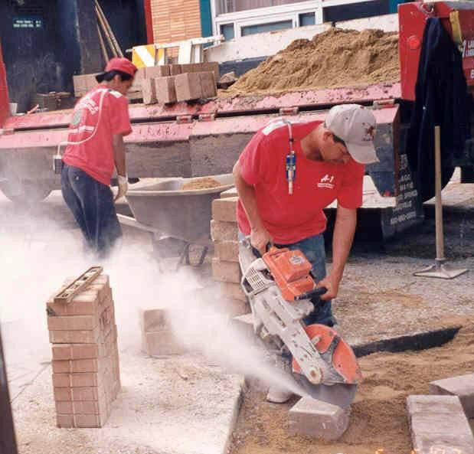
Exposure Assessment
Part 590, 1910.1053 (d) or Part 690, 1926.1153 (d)(2)
The employer shall assess the exposure of each employee who is or may reasonably be expected to be exposed to respirable crystalline silica at or above the action level in accordance with either the performance option in paragraph (d)(2)(ii) or the scheduled monitoring option in paragraph (d)(2)(iii) of this section.

Slide 36



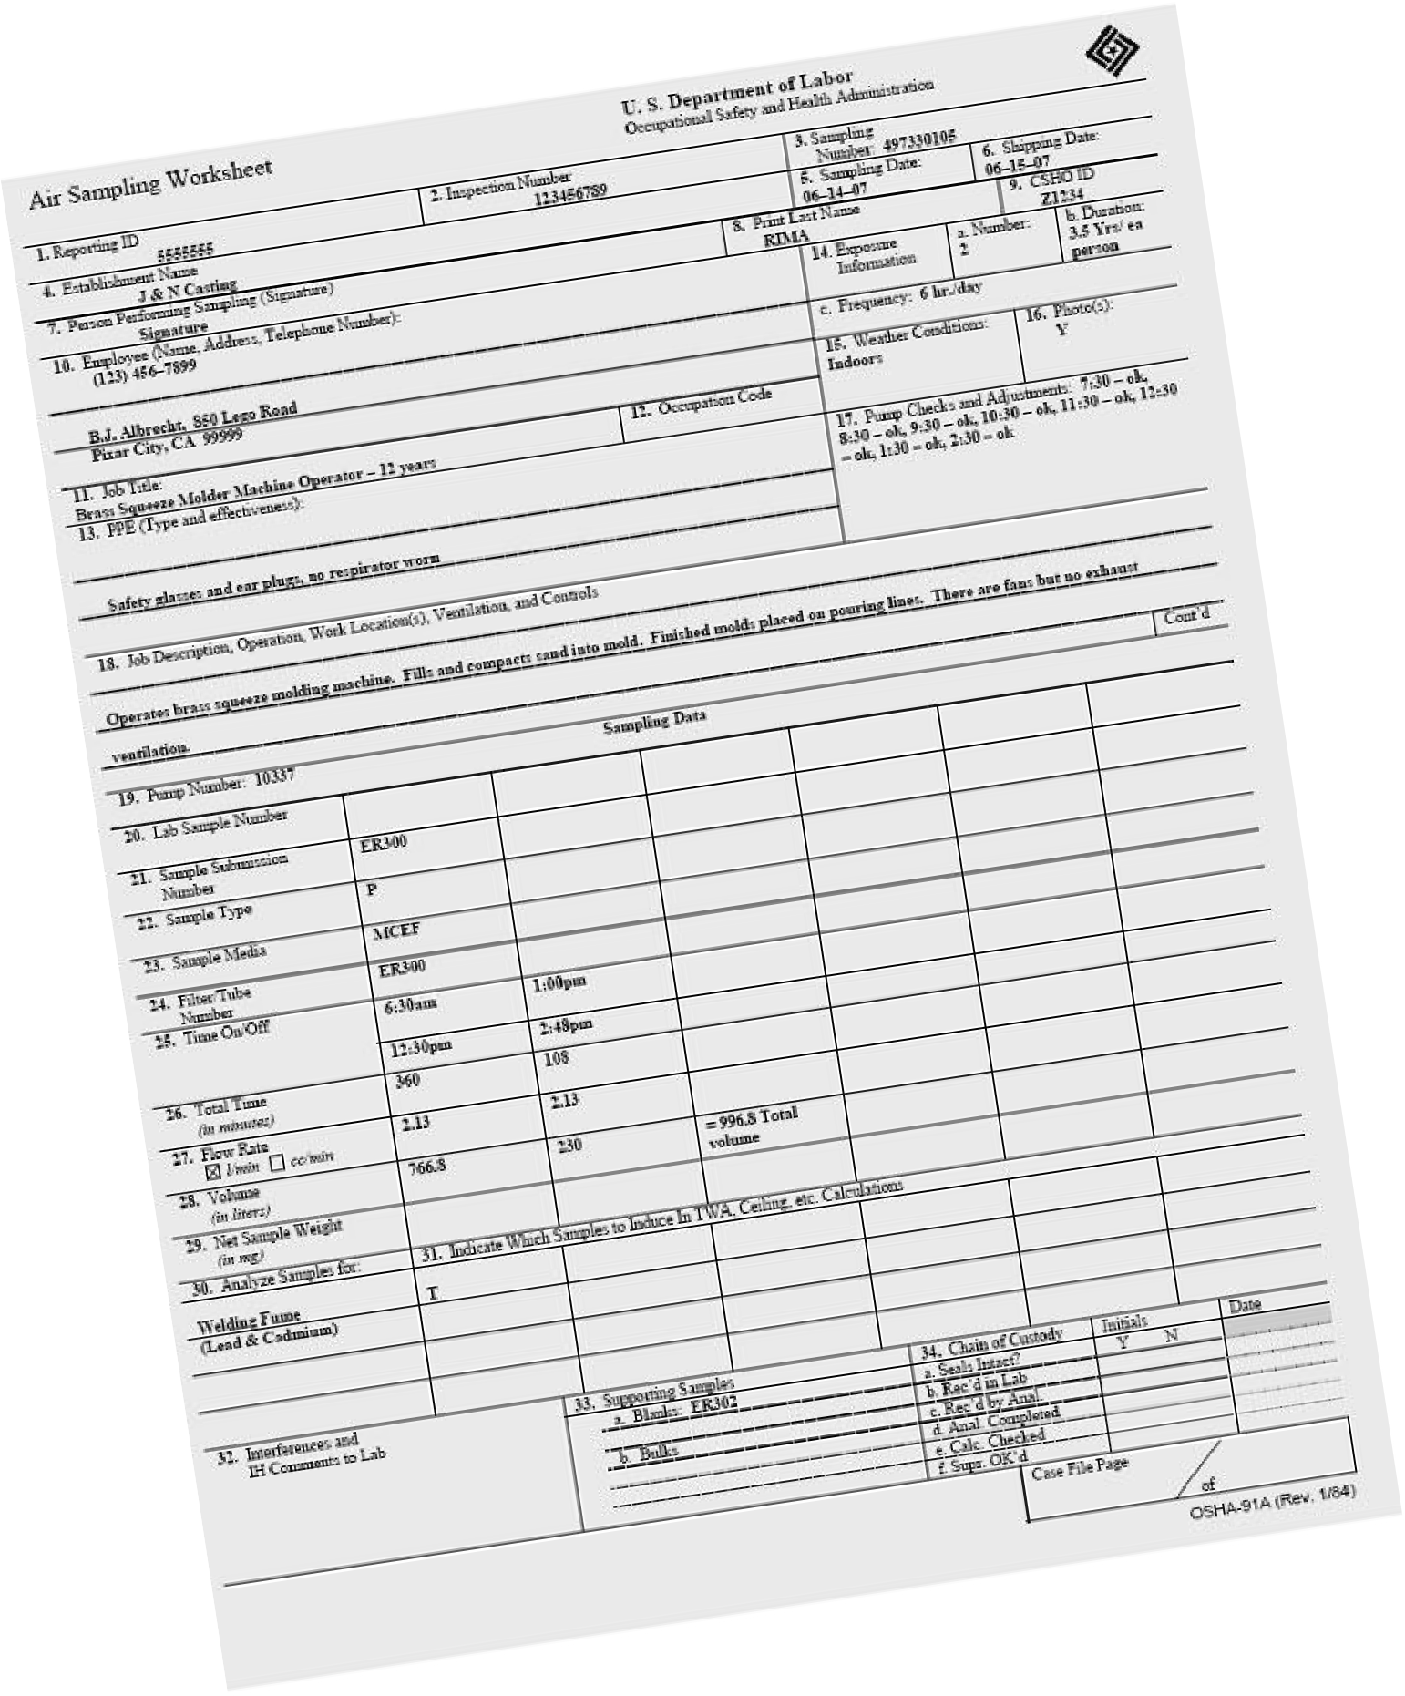
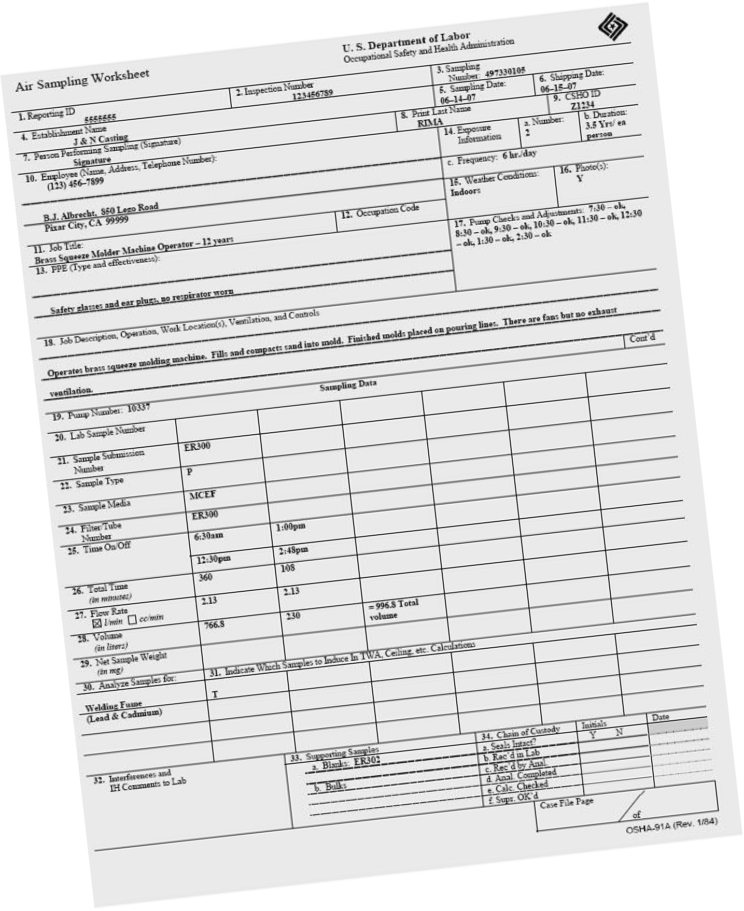
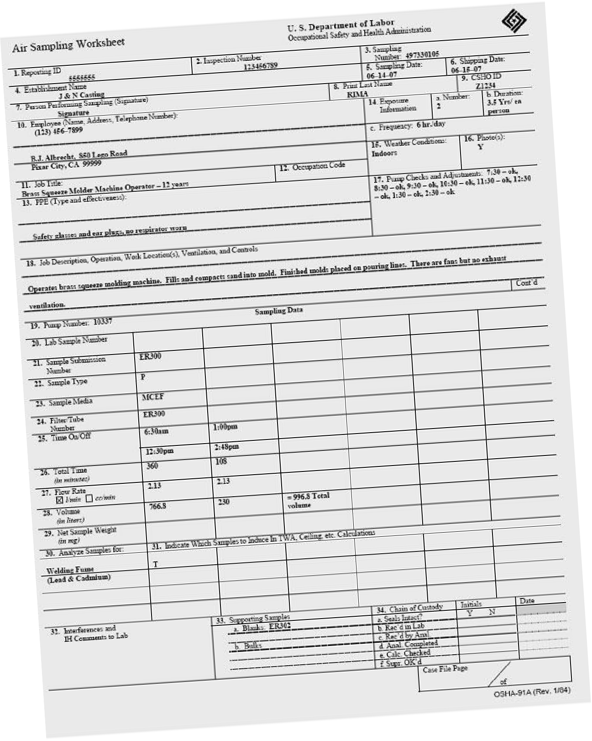
Exposure Assessment
Part 590, 1910.1053 (d)(2) or Part 690, 1926.1153 (d)(2)(ii)
The employer shall assess the 8-hour TWA exposure for each employee on the basis of any combination of air monitoring data or objective data sufficient to accurately characterize employee exposures to respirable crystalline silica.

Slide 37
Scheduled Monitoring Option
Part 590, 1910.1053 (d)(3) or Part 690, 1926.1153 (d)(2)(iii)
The employer shall perform initial monitoring to assess the 8- hour TWA exposure for each employee on the basis of one or more personal breathing zone air samples that reflect the exposures of employees on each shift, for each job classification, in each work area.
Where several employees perform the same tasks on the same shift and in the same work area, the employer may sample a representative fraction of these employees in order to meet this requirement.
In representative sampling, the employer shall sample the employee(s) who are expected to have the highest exposure to respirable crystalline silica.

Slide 38


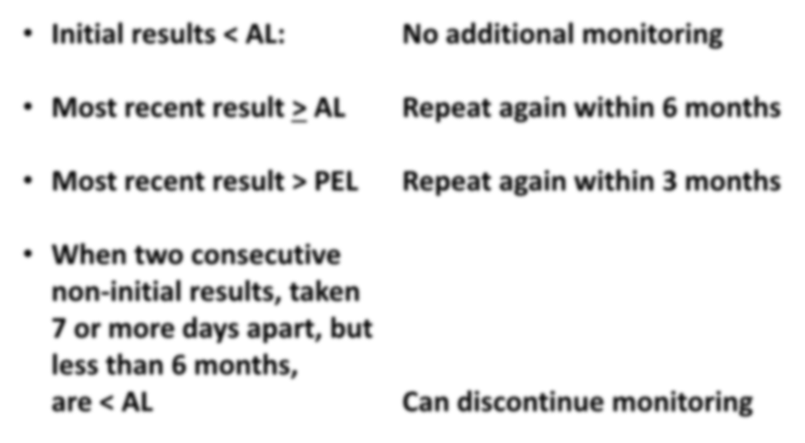


Frequency of Monitoring
Initial results < AL:
No additional monitoring
Most recent result > AL
Repeat again within 6 months
Most recent result > PEL
Repeat again within 3 months
When two consecutive non-initial results, taken 7 or more days apart, but less than 6 months,
are < AL
Can discontinue monitoring
REASSESS!
If/when conditions change...

Slide 39
Reassessment of Exposures
Part 590, 1910.1053 (d)(4) or Part 690, 1926.1153 (d)(2)(iv)
Reassess exposures whenever a change in the production, process, control equipment, personnel, or work practices may reasonably be expected to result in new or additional exposures at or above the action level, OR
When the employer has any reason to believe that new or additional exposures at or above the action level have occurred.

Slide 40

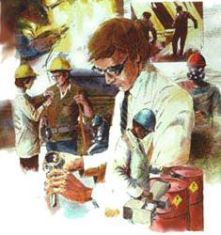
Methods of Sample Analysis
Part 590, 1910.1053 (d)(5) or Part 690, 1926.1153 (d)(2)(v)
Employers must ensure that samples are analyzed by a laboratory that follows the procedures in Appendix A.
Appendix A specifies methods of sample analysis:
  Allows for use of OSHA, NIOSH, or MSHA
methods (six methods specified).
  Analysis must be conducted by accredited laboratories that follow specified quality control procedures.
40

Slide 41
Employee Notification
Part 590, 1910.1053 (d)(6) or Part 690, 1926.1153 (d)(2)(vi)
Individually notify in writing each affected employee within 5 days of the exposure assessment of the results of that assessment or post the results in an appropriate location accessible to all affected employees.
Whenever an exposure assessment indicates that employee exposure is above the PEL, the employer shall describe in the written notification the corrective action being taken to reduce employee exposure to or below the PEL.

Slide 42
Observation of Monitoring
Part 590, 1910.1053 (d)(7) or Part 690, 1926.1153 (d)(2)(vii)
Where air monitoring is performed to comply with the requirements of this section, the employer shall provide affected employees or their designated representatives an opportunity to observe any monitoring of employee exposure to respirable crystalline silica.
When observation of monitoring requires entry into an area where the use of protective clothing or equipment is required for any workplace hazard, the employer shall provide the observer with protective clothing and equipment at no cost and shall ensure that the observer uses such clothing and equipment.

Slide 43
Regulated Area
Only in Part 590, 1910.1053 (e)
An area, demarcated by the employer, where an
employee’s exposure to airborne concentrations of respirable crystalline silica exceeds, or can reasonably be expected to exceed, the
PEL.
Note the improper use of respiratory protection (i.e., the respirator should be the first PPE on and the last off; the straps should be under the hood.

Slide 44
Methods of Compliance
Part 590, 1910.1053 (f) or Part 690, 1926.1153 (d)(3)
General industry:
  Engineering and work practice controls, 1910.1053 (f)(1)
  Written exposure control program, 1910.1053 (f)(2)
  Abrasive blasting 1910.1053 (f)(3)
Construction:
  Engineering and work practice controls, 1926.1153 (d)(3)(i)
  Abrasive blasting, 1926.1153 (d)(3)(ii)

Slide 45

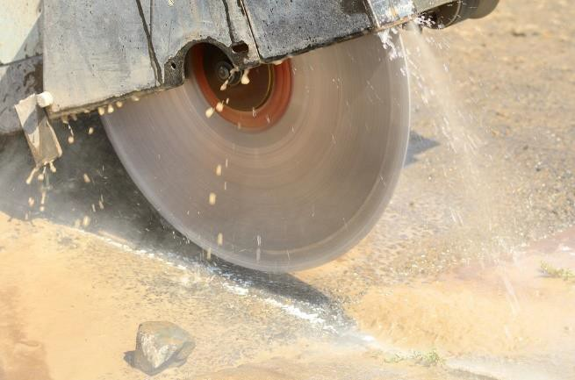

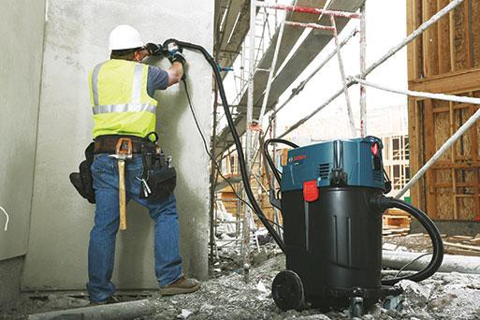
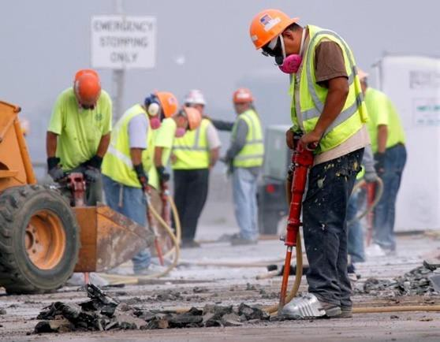
Engineering and Work Practice Controls
Part 590, 1910.1053 (f)(1) or Part 690, 1926.1153 (d)(3)(i)
Employers shall use engineering and work practice controls to limit exposures to or below the PEL unless they are demonstrated to be not feasible.
Use such controls even if they do not reduce exposures to or below the PEL; use to achieve lowest feasible level.
Respirators permitted where PEL cannot be achieved with engineering and work practice controls
Wet methods
HEPA
vacuum
HEPA-filtered respiratory protection

Slide 46

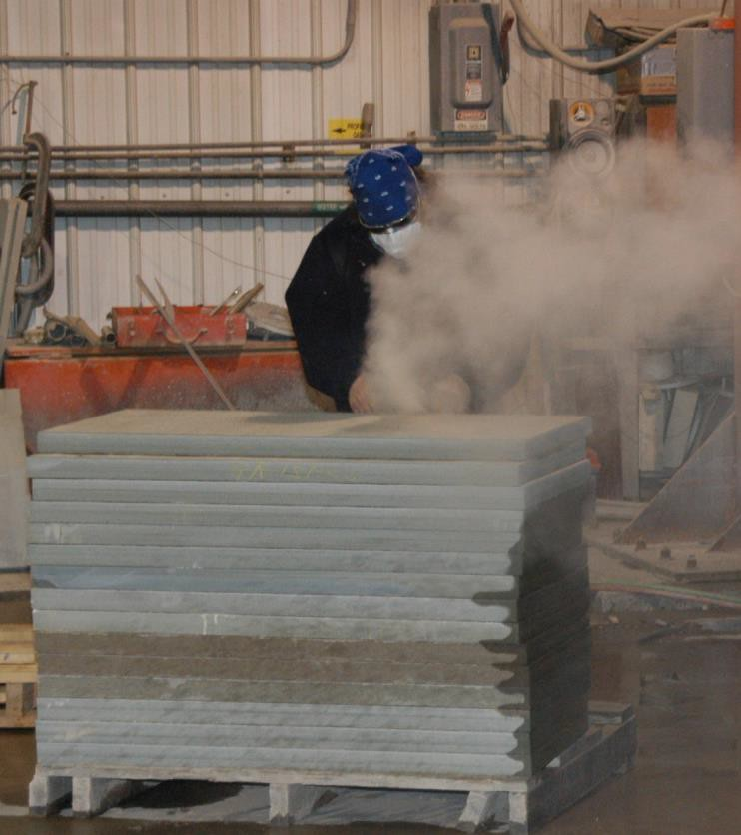
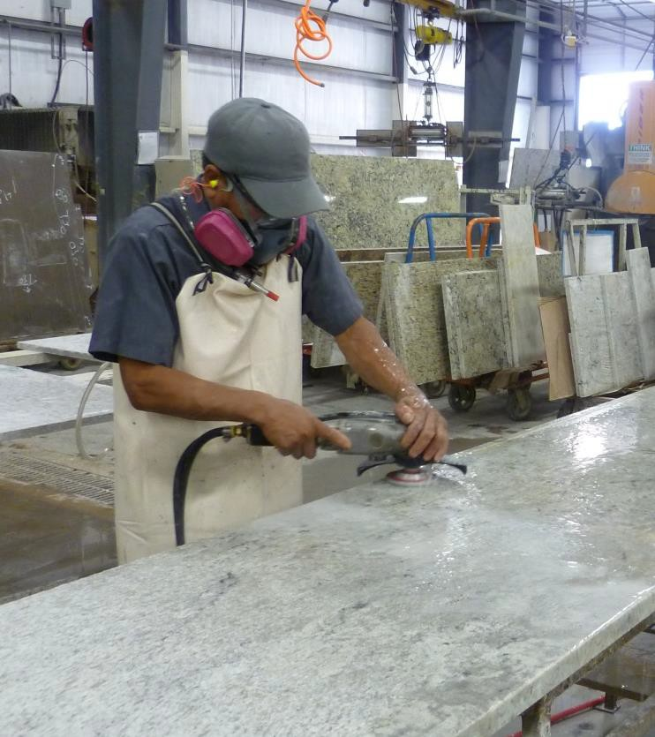
Construction Engineering Control Example 1
Grinding/Polishing Stone
Grinding stone
without engineering controls
Polishing stone using water to control the dust

Slide 47


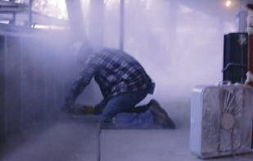
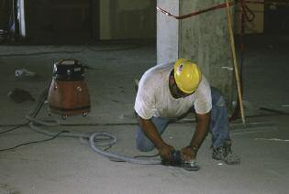
Construction Engineering Control Example 2
Grinding
Grinding without engineering
controls
Grinding using a vacuum dust collector

Slide 48


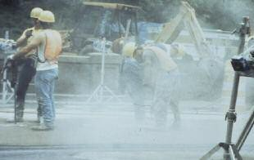
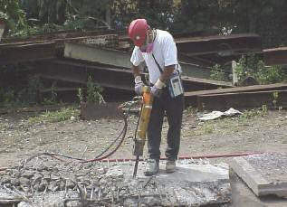
Construction Engineering Control Example 3
Jackhammer
Jackhammer use without
engineering controls
Jackhammer use with water
spray to control dust

Slide 49

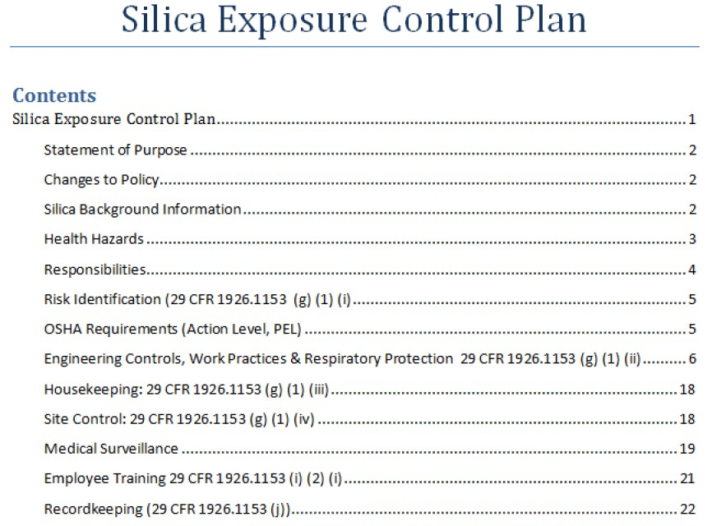
Written Exposure Control Plan
Part 590, 1910.1053 (f)(2) or Part 690, 1926.1153 (g)
The employer shall establish and implement a written exposure control plan that contains at least the following elements:
Description of:
  Tasks with respirable silica exposure
  Control measures, etc.
  Housekeeping measures
  Procedures use to restrict access to work areas (construction only).

Slide 50
Written Exposure Control Plan – continued
Part 590, 1910.1053 (f)(2) or Part 690, 1926.1153 (g)
Review the plan annually; update
as necessary.
Make the plan readily available.
50

Slide 51

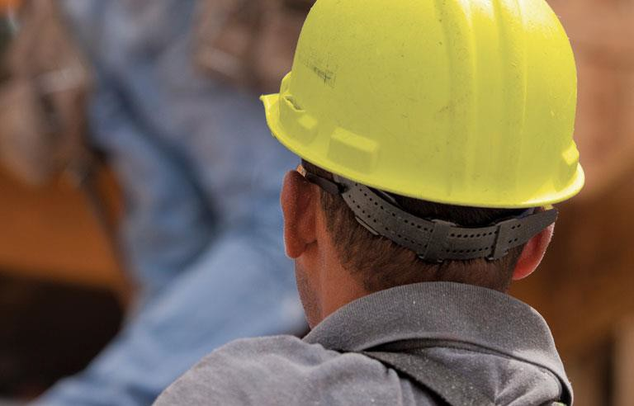
Competent Person
Part 690, 1926.1153 (g)(4)
The employer shall designate a competent person to:
Make frequent and regular inspections of job sites, materials, and
equipment to…
Implement the written exposure control plan.

Slide 52

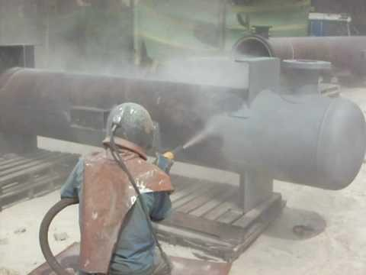
Abrasive Blasting
Part 590, 1910.1053 (f)(3) or Part 690, 1926.1153 (d)(3)(ii)
The employer shall comply with other OSHA standards, when applicable, such as (MIOSHA Part 620), where abrasive blasting is conducted using crystalline silica- containing blasting agents, or where abrasive blasting is conducted on substrates that contain crystalline silica.

Slide 53

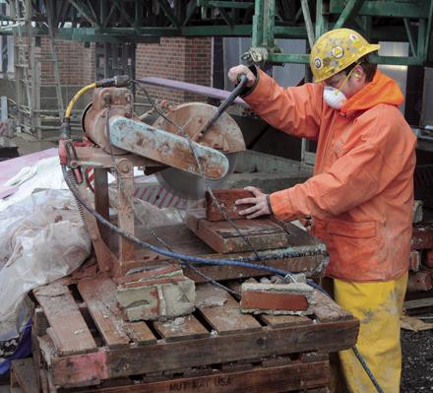
Respiratory Protection
Part 590, 1910.1053 (g) or Part 690, 1926.1153 (e)
Must comply with MIOSHA Part 451.
If exposures exceed the PEL, respirators are required:
  For tasks where controls and/or work
practices are not feasible.
  While installing or implementing feasible controls and/or work practices.
  When implemented feasible controls measures and/or work practices do not reduce exposures below the PEL.
  As required by Table 1 for construction employers.
  While employees are in a regulated area for GI employers.

Slide 54

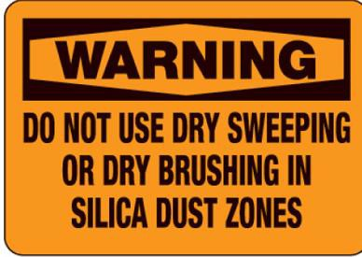

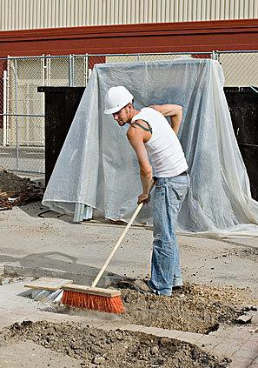
Housekeeping – Dry Sweeping/Brushing
Part 590, 1910.1053 (h)(1) or Part 690, 1926.1153 (f)(1)
The employer shall not allow dry sweeping or dry brushing where such activity could contribute to employee exposure to respirable crystalline silica …unless…
Wet sweeping, HEPA-filtered vacuuming or other methods that minimize the likelihood of exposure are not feasible.

Slide 55

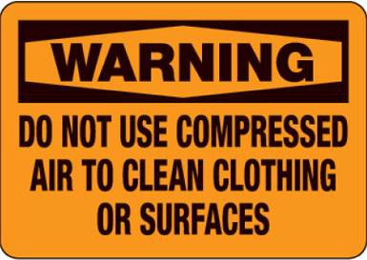

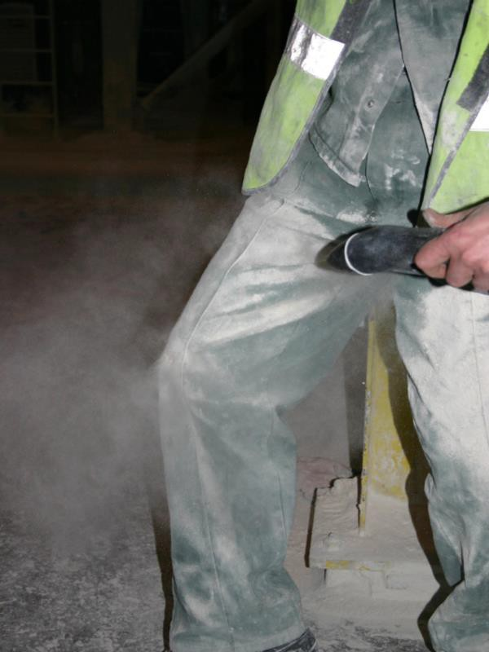
Housekeeping – Compressed Air
Part 590, 1910.1053 (h)(2) or Part 690, 1926.1153 (f)(2)
The employer shall not allow compressed air to be used to clean clothing or surfaces where such activity could contribute to employee exposure to respirable crystalline silica unless:
The compressed air is used in conjunction with a ventilation system that effectively captures the dust cloud created by the compressed air; OR
No alternative method is feasible.

Slide 56

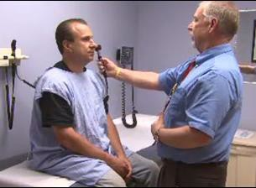
Medical Surveillance
Part 590, 1910.1053 (i) or Part 690, 1926.1153 (h)
PROVISION (within 30 days after initial assignment):
General Industry: Employers must make available medical examinations to workers exposed above the action level (AL) under Part 590 for 30 or more days a year.
Construction: Employers must make available medical examinations to workers required to wear a respirator under Part 690 for 30 or more days a year.

Slide 57
Medical Surveillance
Part 590, 1910.1053 (i) or Part 690, 1926.1153 (h)
FREQUENCY and CONTENT:
Employers must offer examinations every three years to workers who continue to be exposed above the trigger.
Exam includes: medical and work history, physical exam, chest X-ray, and pulmonary function test, TB test (on initial exam only), and any other test deemed appropriate by the PLHCP.

Slide 58

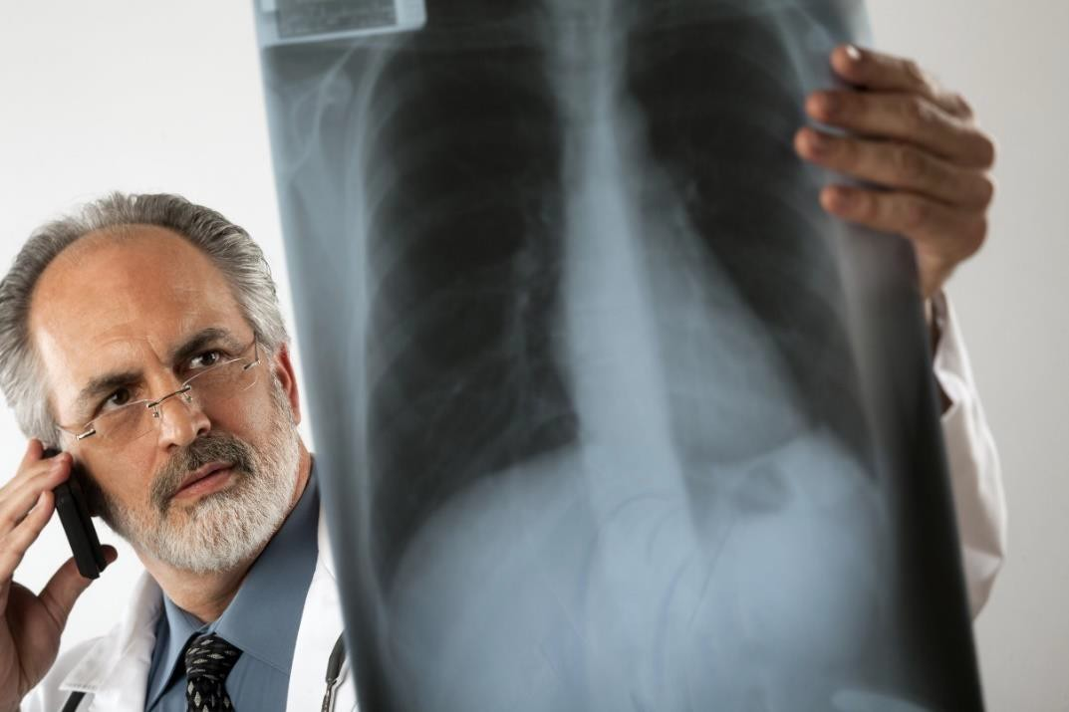
Medical Surveillance
Part 590, 1910.1053 (i) or Part 690, 1926.1153 (h)
Worker receives report with detailed medical findings.
Employer receives an opinion that only describes limitations on respirator use, and if the worker gives written consent, recommendations on:
  Limitations on exposure to respirable
crystalline silica, and/or
  Examination by a specialist.

Slide 59


Communication of Silica Hazards – HAZCOM
Part 590, 1910.1053 (j) or Part 690, 1926.1153 (i)
HAZARD COMMUNICATION
Include respirable crystalline silica in the program established to comply with the hazard communication standard (HCS) (29 CFR 1910.1200).
Ensure that each employee has access to labels on containers of crystalline silica and safety data sheets, and is trained in accordance with the provisions of HCS and Part 590 or 690.
Ensure that at least the following hazards are addressed: cancer, lung effects, immune system effects, and kidney effects.

Slide 60
Communication of Silica Hazards – Info/Train
Part 590, 1910.1053 (j) or Part 690, 1926.1153 (i)
Each employee shall demonstrate knowledge and understanding of:
Health hazards associated with exposure to respirable crystalline silica;
Specific tasks in the workplace that could result in exposure to
respirable crystalline silica;
Specific measures the employer has implemented to protect employees from exposure to respirable crystalline silica, including engineering controls, work practices, and respirators to be used;
Contents of MIOSHA Part 590 or Part 690, as appropriate;
Identity of the competent person designated by the employer (Part 690 only); AND
Purpose and a description of the medical surveillance program.
60

Slide 61

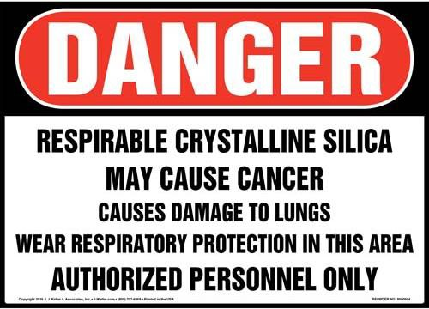
Communication of Silica Hazards – Signage
Part 590, 1910.1053 (j)
SIGNAGE
Post signs at all entrances to regulated areas that contain the information identified on this slide.
NOTE: This sign is only required by Part 590; it is not required by Part 690.

Slide 62


Recordkeeping
Part 590, 1910.1053 (k) or Part 690, 1926.1153 (j)
Make and maintain accurate records:
  Air monitoring data,
  Objective data, AND
  Medical records.
Content of records specified by the standard.

Slide 63

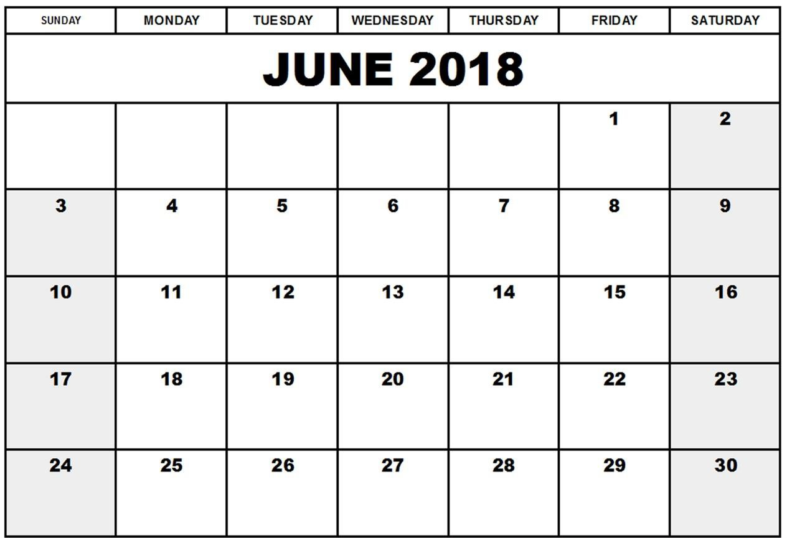
Dates: General Industry Standard
Part 590, Rule 59005
Employers must comply with all requirements by June 23, 2018 except:
Hydraulic fracturing operations in the
oil and gas industry:
  Medical surveillance: see below.
  Engineering controls: June 23, 2021.
  All other provisions: June 23, 2018.
Medical surveillance obligations in paragraph (i)(1)(i):
  Employees exposed > 30 days or more per year at or above the PEL: June 23, 2018.
  Employees exposed > 30 days or more per
year at or above the AL: June 23, 2020.
23

Slide 64

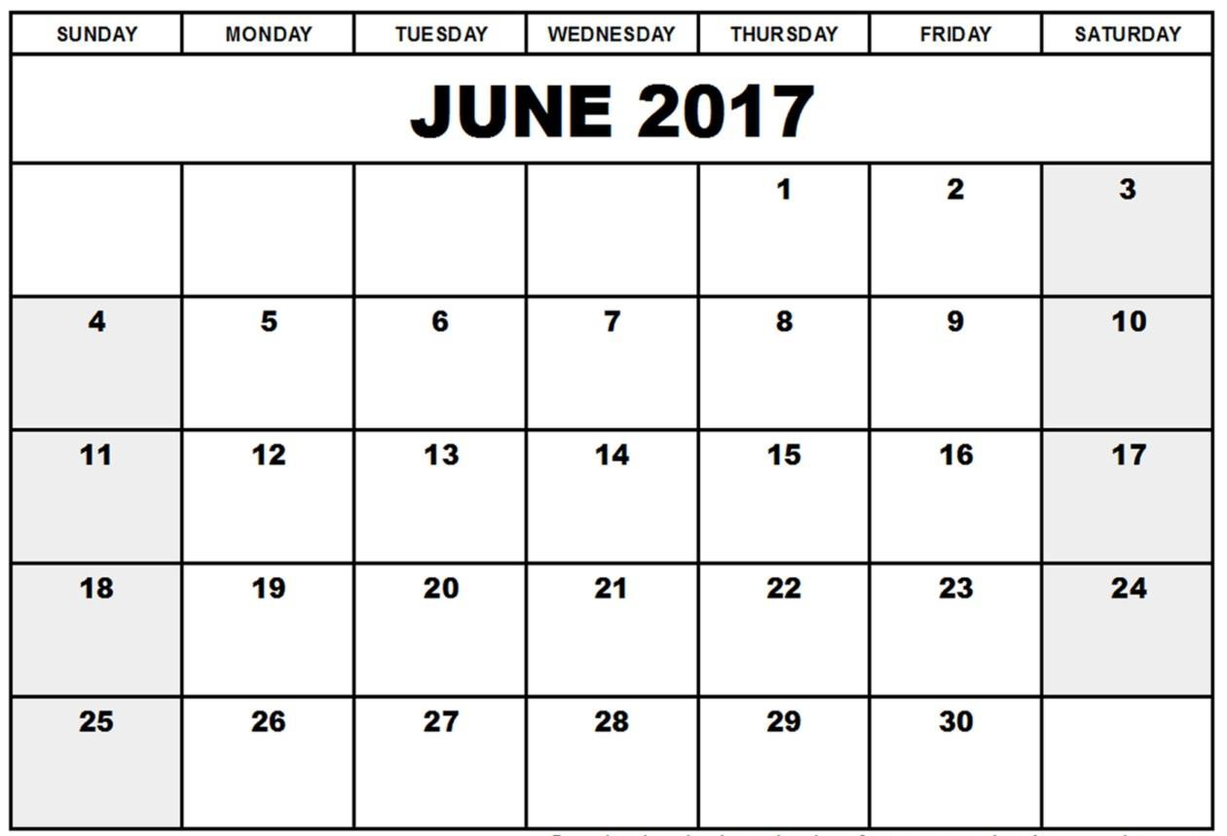
Dates: Construction Standard
Part 690, Rule 69005
Employers must comply with all requirements, except methods of sample analysis, paragraph (d)(2)(v), by June 23, 2017.
23

Slide 65
Dates: Construction Standard – continued
Part 690, Rule 69005
Compliance with methods of sample analysis required by June 23, 2018.
Methods of sample analysis, section
(d)(2)(v):
The employer shall ensure that all samples taken to satisfy the monitoring requirements of paragraph (d)(2) of this
23
section are evaluated by a laboratory that analyzes air samples for respirable crystalline silica in accordance with the procedures in Appendix A to this section.

Slide 66

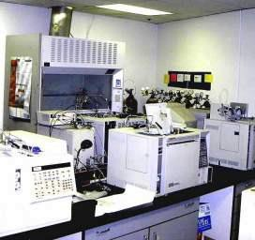
Appendix A: Methods of Sample Analysis
Part 590 and Part 690
Specifies procedures for analyzing air samples for respirable crystalline silica and quality control procedures employers must ensure laboratories use when performing an analysis.
The employer must ensure the laboratory:
  Evaluates all samples using one of six analytical methods;
  Is accredited with respect to crystalline silica analyses;
  Uses the most current traceable standards for instrument
calibration or instrument calibration verification;
  Implements an internal quality control (QC) program;
  Characterizes the sample material; AND
  Analyzes quantitatively for crystalline silica and performs
specified instrument calibration checks.

Slide 67
Appendix B: Medical Surveillance Guidelines
Part 590 and Part 690
Appendix is divided into seven sections:
Section 1: Recognition of silica-related diseases.
Section 2: Medical surveillance.
Section 3: Roles and responsibilities.
Section 4: Confidentiality and other considerations.
Section 5: Resources.
Section 6: References.
Section 7: Sample forms.

Slide 68
Resources
Silica Small Entity Compliance Guide for Construction www.osha.gov/Publications/OSHA3902.pdf
OSHA Crystalline Silica Fact Sheet
osha.gov/OshDoc/data_General_Facts/crystalline-factsheet.pdf
NIOSH Silica Information Webpage www.cdc.gov/niosh/topics/silica

Slide 69


Resources (continued)
Center for Protection of Worker Rights
Center for Construction Research and Training www.silica-safe.org
Video clips – What’s Working
http://www.silica-safe.org/whats-working/controlling-silica-dust-learning-from-each- other
Federal Register – Silica Standard
https://www.federalregister.gov/documents/2016/03/25/2016-04800/occupational- exposure-to-respirable-crystalline-silica
Hollow drill bits for rotary hammers with local exhaust ventilation https://www.youtube.com/watch?v=iC-Ze4jTs0M

Slide 70


Keep your head out of the clouds…but don’t
bury it in the pile either!
Begin to determine how the appropriate silica standard may complied with in your workplace today!

Slide 71

Summary
Provided an overview of the content of MIOSHA Part 590, Silica in General Industry, and Part 690, Silica in Construction.

